Slide 1
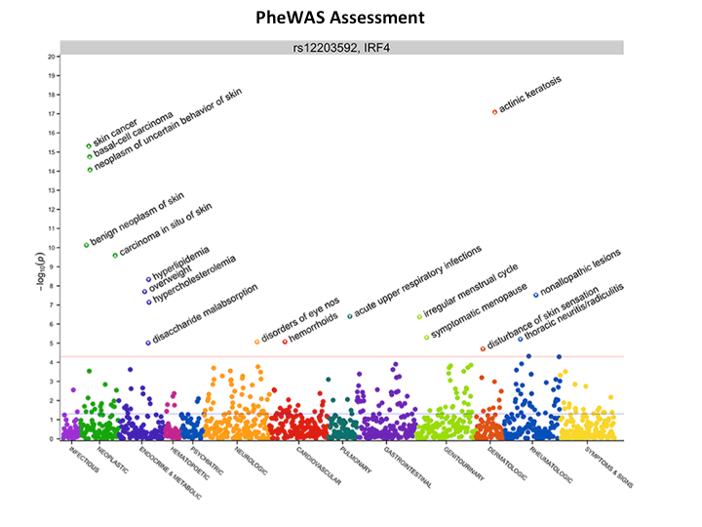
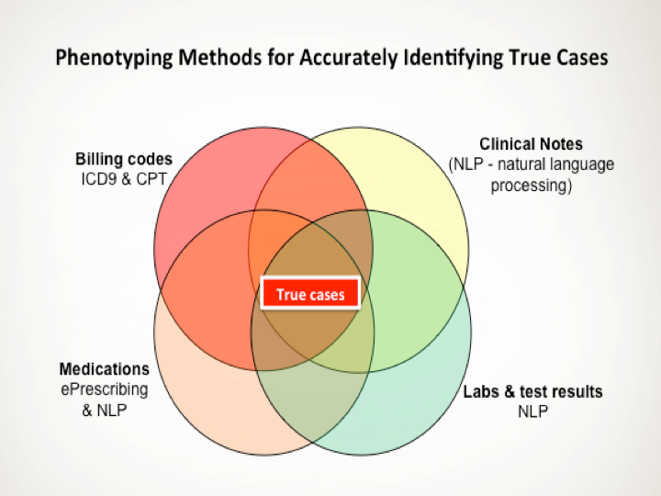
Phenotyping and PheWAS Core Services
Mission
Our core mission is to assist researchers who seek to advance the basic informatics methods, and to apply advanced methods to "understand" unstructured, and sometimes inaccurate, biomedical text and electronic medical record data.
For basic science applications, we provide services for natural language processing methods, terminology development, and integration of disparate data sources (such as coded and free text sources).
We provide two major domains of application of advanced informatics techniques: educational informatics and clinical phenotyping (deriving phenotypes from EMR records). We pursue the latter to discover clinical knowledge, gene-disease relationships (genomics, GWAS, and PheWAS), and gene-drug-outcome relationships (pharmacogenomics).

Slide 2
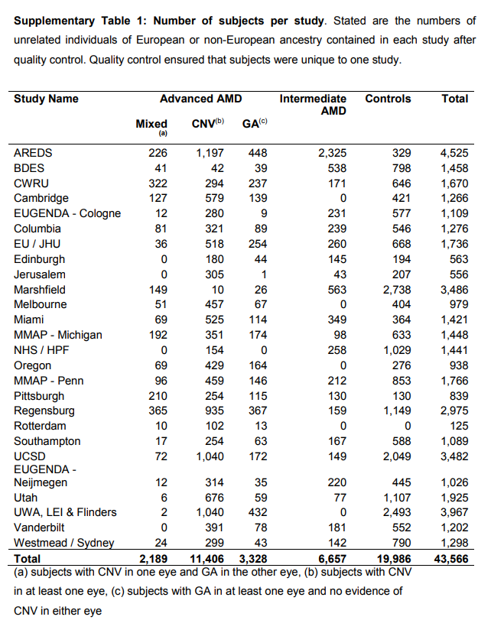
265 advanced AMD and 563 intermediate AMD and 2738 control

